Slide 1

Camera Shots & Angles

Slide 2
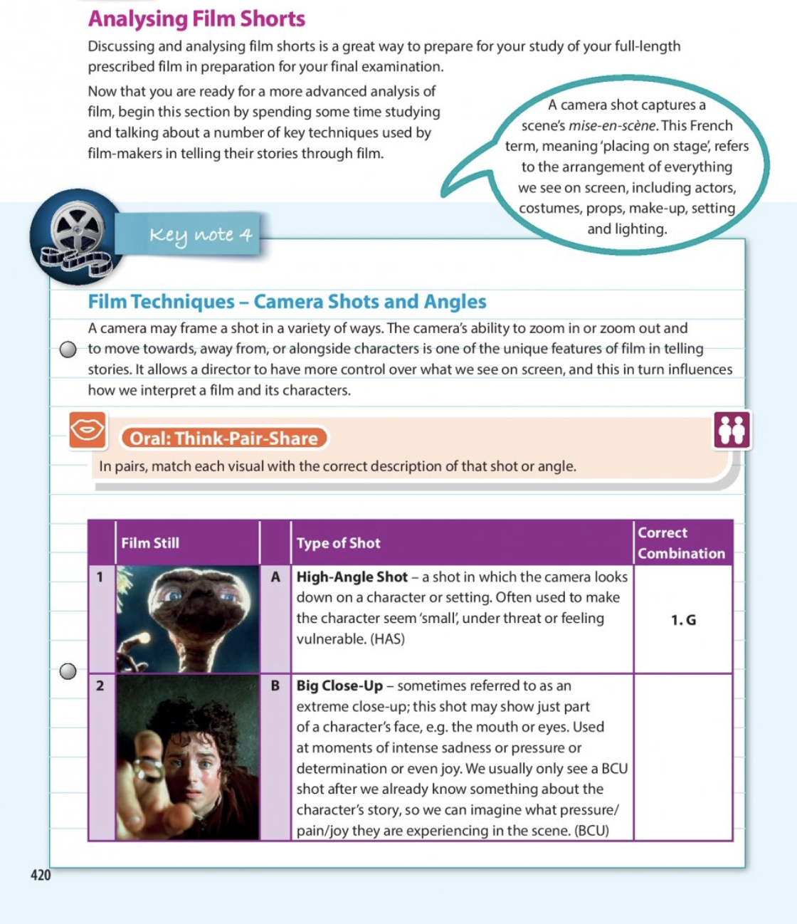

Slide 3
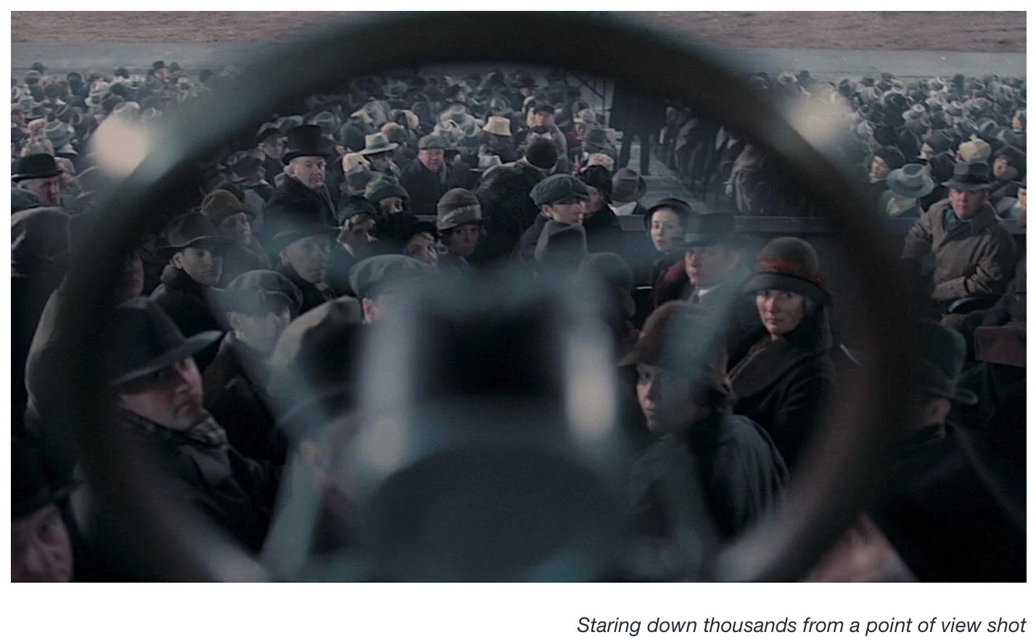
Point of view shot
Shows a particular character's perspective
As if you are seeing from their eyes
Often used in horror or suspense

Slide 5
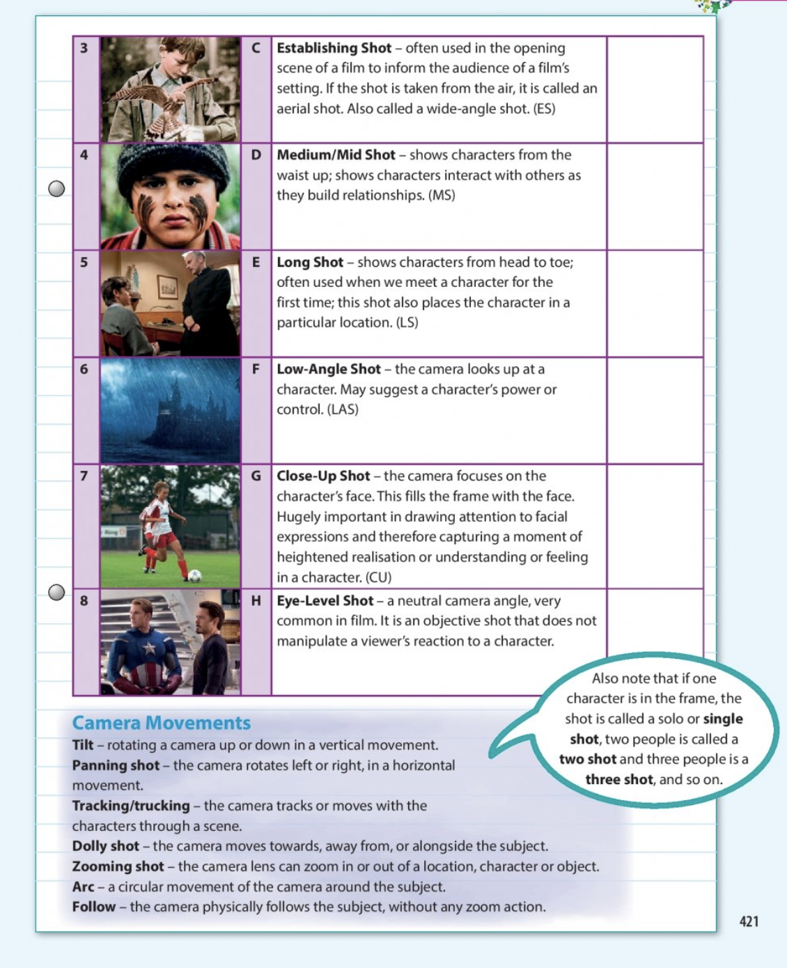

Slide 7
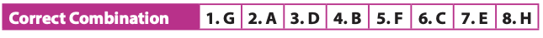

Slide 8
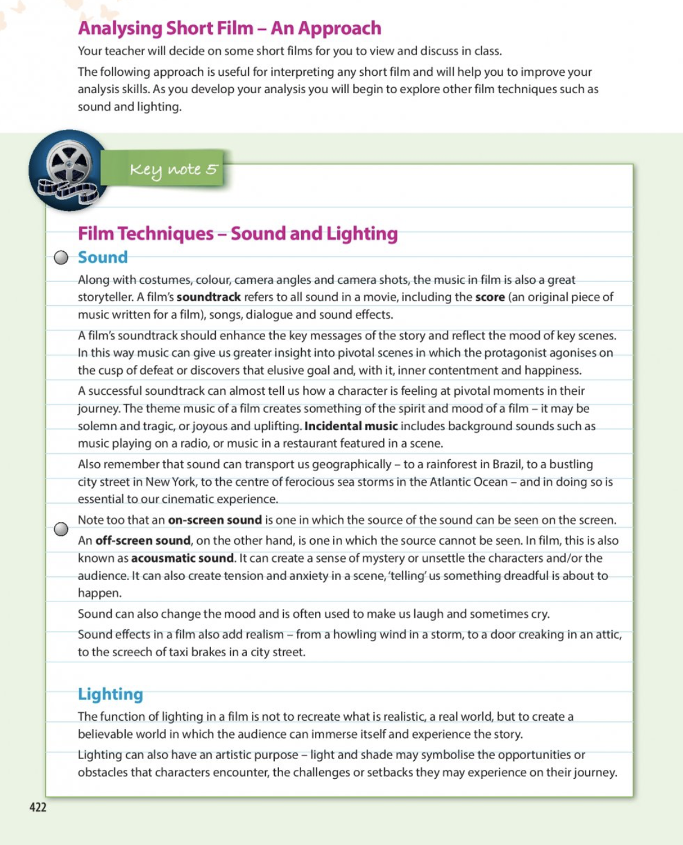

Slide 10
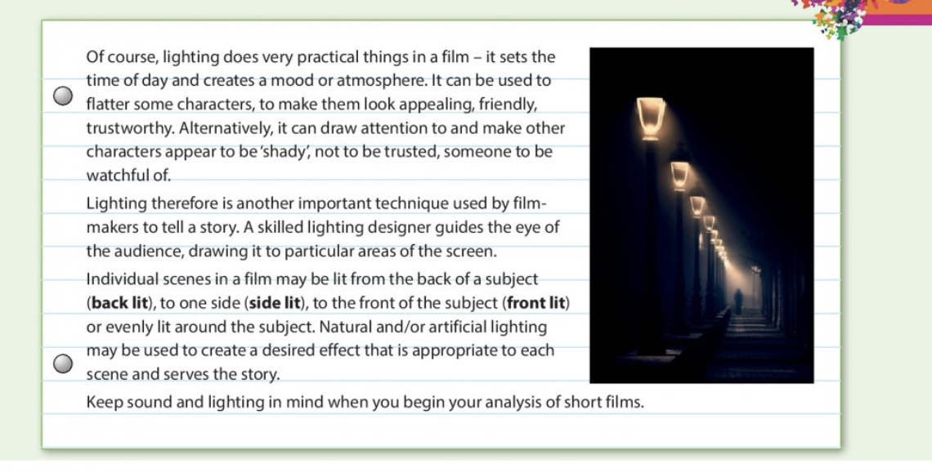

Slide 11
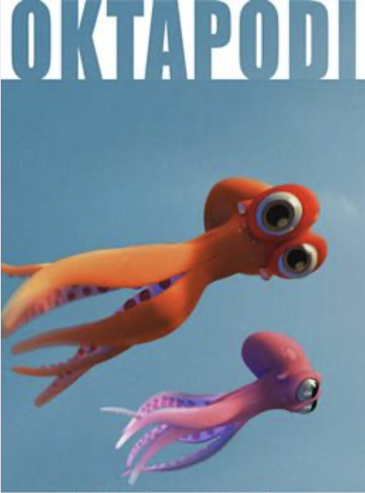
https://www.youtube.com/watch?v=badHUNl2HXU

Slide 12
Page 203 Thrash It Out Questions
An established shot revealed that the octopuses were in a tank which is located in a fish mongers shop and that one has been taken away.
A close-up shot on the octopuses face showed me that they feared for the other octopuses life. They knew they were in danger and the close up shot allowed me to see how scared they were.
A point of view shot illustrated the perspective of the octopus being left behind and allowed us to see the logo on the van and realise the danger the other octopus was in.
Notes:
Establishing Shot – 0:25 – looking through the glass of the tank, the octopus realises his lover is being taken away
Close up shot – 0:30 – orange octopuses face
Point of view shot – 0:23 – octopus looking at lover being taken away
Point of view shot - 0:47 – octopus looking in van window

Slide 13
Page 203 Thrash It Out Questions
A high-angle shot was used when the two octopuses are jumping from pool to pool heading towards the sea
A low angle shot was used when the man got into the van and placed the cooler box with the octopus inside on the seat.
Notes:
High angle shot – 1:29
Low angle shot – 0:33

